Slide 1
Decision Making for Two Samples
Chapter 5

Slide 2
True Story
In the 1980’s, the Hughes Aircraft Co. (HAC) bought cryogenic coolers for their Bradley Fighting Vehicle night vision assemblies from two different vendors:
Hughes Aircraft Co. (HAC) Santa Barbara (in-house)
BAC (out-of-house)
After installation into the Bradley Fighting Vehicles, the HAC coolers seemed to be failing sooner than the BAC coolers
How could the engineers determine if there was a significant difference between the mean lives of the HAC coolers and the BAC coolers?
Use IEE 380 Chapter 5 methods!

Slide 3

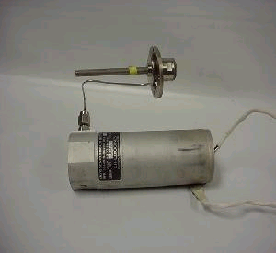
Bradley Fighting Vehicle
Cooler
www.us-army-info.com
www.rdysales.com

Slide 4
Case 1. Hypothesis tests on the difference between two means Variances Known

Slide 5
Z
The statistic
This Z is standard normal.

Slide 6
Case 1: Test of Hypothesis on Difference Between Two Means Variances Known
Reject H₀ if |z₀ | > z_{α/2} Reject H₀ if z₀ > z_{α} Reject H₀ if z₀ < - z_{α}
P-value = 2[1-φ(|z₀|)] P-value = 1 – φ(z₀) P-value = φ(z₀)
Reject H₀ if p-value is < α
TI-83/84:
STAT→TESTS→3: 2-SampZTest

Slide 7
Two-Sided Confidence Interval on Population Mean, μ
A (1-α)% confidence interval on the true difference between means is given by L and U:
L: lower value
U: Upper value
TI-83/84:
STAT→TESTS→9: 2-SampZInt

Slide 8
One-Sided Confidence Intervals on Population Mean, μ
A (1-α)% confidence interval on the true difference between means μ is given by L and U:
Note: There is no Δ₀ in this equation, because we would only be interested in the difference between the means for a CI
L: lower value
U: Upper value

Slide 9
Accommodating Δ₀ TI-83, 84
When you enter Stats data into the 2-SampZTest option, add Δ₀ to the value you input for

Slide 10
Case 5. Hypothesis Tests on the Ratio of Two Variances
Note that I am teaching this case out of order from the text.

Slide 11
Notation
F(x) not equal to F
Chapter 5
Chapter 3:
F(x) denotes the cumulative distribution function (CDF) of both discrete and continuous random variables.
Chapter 5:
The letter F is now used as a RANDOM VARIABLE.
The letter f is now used as a specific value of F
Analogy: X and x.
Chapter 3

Slide 12
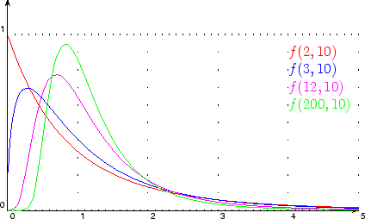
The F Probability Distribution Function (pdf)
W and Y are independent random variables that are each distributed χ² with u and v degrees of freedom, respectively.
The statistic ~ F_{u,v} with pdf
f(x)
F_{2,10}
F_{200,10}
F_{3,10}
F_{12,10}
x
Eq.’s 5-18 and 5-19 page 225

Slide 13
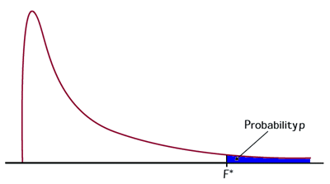
Important
The critical values of f that correspond to α (one-sided tests) or α/2 (two-sided test) have a special relationship:
α
Notice: order of n's
α

Slide 14
Practice with the F table
X is ~ F with 2 and 4 degrees of freedom
Find A such that
P(X > A) = .01
P( X > A) = .05
P(X > A) = .95
P(X < A) = .025
TI-83,84: 2nd → DIST → Fcdf(start, end, u, v)

Slide 15
The Test Procedure
A hypothesis testing procedure for the equality of two variances is based on the following result.
The statistic
If σ²₁ = σ²₂, then

Slide 16
Case 5: Test of Hypothesis on Equality of Two Variances
TI-84:
STAT→TESTS→E: 2-SampFTest
Reject H₀ if p-value is < α

Slide 17
Two-Sided Confidence Interval on Equality of Population Variances
A (1-α)% confidence interval on the true difference between means is given by L and U:
L: lower value
U: Upper value
No stats function for L and U in the TI-83/84 series.

Slide 18
One-Sided Confidence Interval on Equality of Population Variances
A (1-α)% confidence interval on the true difference between means is given by L and U:
L: lower value
U: Upper value

Slide 19
Case 5: Computing the p-value
Clearly state the null and alternative hypotheses, H₀ and H₁.
Determine the numerical value of the test statistic, f₀
3. Plot the pdf of F (Recall that the lowest value is 0)
If you have a two-sided hypothesis test and the test statistic is “closer to zero than to the right tail of the pdf” the p-value is 2x (area below the test statistic)
If you have a two-sided hypothesis test and the test statistic is “closer to the right tail of the pdf” the p-value is 2x (area above the test statistic).
If you have a one-sided upper hypothesis test, the p-value is the area above the test statistic.
If you have a one-sided lower hypothesis test, the p-value is the area below the test statistic.
Two-sided
One-sided upper
One-sided lower

Slide 20
Case 2. Hypothesis tests on the difference between two means variances unknown but assumed to be equal
Do Case 5 two-sided test on the data FIRST.
If you Fail to Reject H₀ from Case 5, then you do a Case 2.

Slide 21
The statistic
where S₁² and S₁² are the sample variances of samples 1 and 2, respectively
n₁ and n₂ are the sample sizes of samples 1 and 2, respectively.
S_{p} is the pooled sample standard deviation, given by

Slide 22
Case 2: Test of Hypothesis on Difference Between Two Means Variances Unknown and Equal
Reject H₀ if |t₀ | > t_{α/2, n1+n2-2} Reject H₀ if t₀ > t_{α,n1+n2-2} Reject H₀ if t₀ < - t_{α,n1+n2-2}
Reject H₀ if p-value is < α
TI-83/84:
STAT→TESTS→4: 2-SampTTest
Pooled? Yes

Slide 23
Two-Sided Confidence Intervals on Population Mean, Variances Unknown and Equal
A (1-α)% confidence interval on the true difference between means is given by L and U:
Note: There is no Δ₀ in this equation, because we would only be interested in the difference between the means for a CI
L: lower value
U: Upper value
TI-83/84:
STAT→TESTS→0: 2-SampTInt

Slide 24
One-Sided Confidence Intervals on Population Mean, Variances Unknown and Equal
A (1-α)% confidence interval on the true difference between means is given by L and U:
Note: There is no Δ₀ in this equation, because we would only be interested in the difference between the means for a CI
L: lower value
U: Upper value

Slide 25
Case 3. Hypothesis tests on the difference between two means variances unknown but assumed to be unequal
Do Case 5 two-sided test on the data FIRST.
If you Reject H₀ from Case 5, then you do a Case 3.

Slide 26
The statistic
where S₁² and S₁² are the sample variances of samples 1 and 2, respectively
n₁ and n₂ are the sample sizes of samples 1 and 2, respectively.
is the degrees of freedom, rounded DOWN to the nearest integer

Slide 27
Case 3: Test of Hypothesis on difference between two means Variances Unknown and Unequal
Reject H₀ if |t₀ | > t_{α/2,ν} Reject H₀ if t₀ > t_{α,ν} Reject H₀ if t₀ < - t_{α,ν}
Reject H₀ if p-value is < α
TI-83/84:
STAT→TESTS→4: 2-SampTTest
Pooled? No

Slide 28
Two-Sided Confidence Interval on Population Mean, μ, Variances UNKNOWN and UNEQUAL
A (1-α)% confidence interval on the true difference between means is given by L and U:
L: lower value
U: Upper value
Note: There is no Δ₀ in this equation, because we would only be interested in the difference between the means for a CI
TI-83/84:
STAT→TESTS→0: 2-SampTInt

Slide 29
One-Sided Confidence Intervals on Population Mean, μ, Variances UNKNOWN and UNEQUAL
A (1-α)% confidence interval on the true difference between means is given by L and U:
Note: There is no Δ₀ in this equation, because we would only be interested in the difference between the means for a CI
L: lower value
U: Upper value

Slide 30
Case 2 and Case 3: Accommodating Δ₀ with TI-83, 84
When you enter Stats data into the 2-SampTTest option, add Δ₀ to the value you input for

Slide 31
Cases 1, 2 and 3: Computing the p-value
Determine the numerical value of the test statistic, z₀ for Case 1 and t₀ for Cases 2 and 3.
For Case 1, draw the pdf of Z, the standard normal random variable. For Cases 2 and 3, draw the pdf of the T distribution.
If you have a two-sided hypothesis test and the test statistic is < 0, the p-value is 2x (area below the test statistic)
If you have a two-sided hypothesis test and the test statistic is > 0, the p-value is 2x (area above the test statistic).
If you have a one-sided upper hypothesis test, the p-value is the area above the test statistic. The test statistic could be < 0 or > 0).
If you have a one-sided lower hypothesis test, the p-value is the area below the test statistic. The test statistic could be < 0 or > 0).
Two-sided
H₀: μ₁ – μ₂ = Δ₀
H₁: μ₁ – μ₂ ≠ Δ₀
One-sided upper
H₀: μ₁ – μ₂ = Δ₀
H₁: μ₁ – μ₂ > Δ₀
One-sided lower
H₀: μ₁ – μ₂ = Δ₀
H₁: μ₁ – μ₂ < Δ₀

Slide 32
Ch. 5 : Cases 1, 2 and 3 Comparison
 | Case 1 | Case 2 | Case
Null | H₀ : μ₁ – μ₂ = Δ₀ | H₀ : μ₁ – μ₂ = Δ₀ | H₀ : μ₁ – μ₂ = Δ₀
Alternative (2-sided) | H₀ : μ₁ – μ₂ ≠ Δ₀ | H₀ : μ₁ – μ₂ ≠ Δ₀ | H₀ : μ₁ – μ₂ ≠ Δ₀
Alternative (1-sided upper) | H₀ : μ₁ – μ₂ > Δ₀ | H₀ : μ₁ – μ₂ > Δ₀ | H₀ : μ₁ – μ₂ > Δ₀
Alternative (1-sided lower) | H₀ : μ₁ – μ₂ < Δ₀ | H₀ : μ₁ – μ₂ < Δ₀ | H₀ : μ₁ – μ₂ < Δ₀
σ₁ and σ₂ | Known. | Do Case 5 first. Unknown, assumed EQUAL, estimated by s₁ and s₂ . Pooled? Yes | Do Case 5 first. Unknown, assumed UNEQUAL, estimated by s₁ and s₂ . Pooled? No
Test Statistic | z | t₀ | t₀
Degrees of freedom | Not applicable | n₁ + n₂ - 2 | ν

Slide 33
Case 4. Test of Hypothesis on Mean Difference of Two Treatments (one population) Variance Unknown

Slide 34
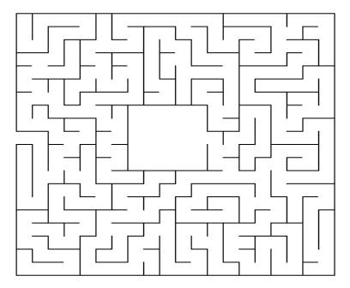
Case 4. Test of Hypothesis on Mean Difference of Two Treatments (one population) Variance Unknown

Slide 35
What if we want to do a hypothesis test on the differences between pairs of data whose variance of the difference is unknown?
Paired T-Test

Slide 36
Example Situation 1
You want to test the hypothesis that the heart rate of a male is higher by at least 20 beats per minute after going down and up one flight of stairs three (3) times
What sort of experiment would you set up?

Slide 37
Example Situation 2
From the Journal of the American Medical Association (JAMA):
Ten adult males ages 45 - 55 are recruited to study a new cholesterol medication.
Analysts wish to determine if the medication decreases the total cholesterol levels in this population.

Slide 38
Data
X₁ and X₂
are random
variables
D = X₁ - X₂
is a random
variable
n=10
d₁
d₂
etc.
D is a random
variable
S²_{D} and S_{D}
are random
variables

Slide 39
T
The statistic
where S_{D} is the sample standard deviation of the difference in paired observations
n is the sample size.
n-1 is the degrees of freedom

Slide 40
Case 4: Test of Hypothesis on Mean Difference of Two Treatments
(one population) Variance Unknown
Reject H₀ if |t₀ | > t_{α/2,n-1} Reject H₀ if t₀ > t_{α, n-1} Reject H₀ if t₀ < - t_{α,n-1}
Reject H₀ if p-value is < α
Note that this is exactly Case 2 from Ch. 4, a test of hypothesis on a mean.
TI-83/84:
STAT→TESTS →2: T-Test

Slide 41
Two-Sided Confidence Interval on Mean Difference (one population) Variance Unknown
A (1-α)% confidence interval on the true difference is given by L and U:
L: lower value
U: Upper value
TI-83/84:
STAT→TESTS →8: TInterval

Slide 42
Two-Sided Confidence Interval on Mean Difference (one population) Variance Unknown
A (1-α)% confidence interval on the true difference is given by L and U:
L: lower value
U: Upper value

Slide 43
Cases 4: Computing the p-value
Determine the numerical value of the test statistic, t₀ .
Draw the pdf of the T distribution.
If you have a two-sided hypothesis test and the test statistic is < 0, the p-value is 2x (area below the test statistic)
If you have a two-sided hypothesis test and the test statistic is > 0, the p-value is 2x (area above the test statistic).
If you have a one-sided upper hypothesis test, the p-value is the area above the test statistic. The test statistic could be < 0 or > 0).
If you have a one-sided lower hypothesis test, the p-value is the area below the test statistic. The test statistic could be < 0 or > 0).
Two-sided
H₀: μ_{d} = Δ₀
H₁: μ_{d} ≠ Δ₀
One-sided upper
H₀: μ_{d} = Δ₀
H₁: μ_{d} > Δ₀
One-sided lower
H₀: μ_{d} = Δ₀
H₁: μ_{d} < Δ₀

Slide 44
Case 6. Hypothesis Tests on the Equality of Two Proportions

Slide 45
Notation
n₁ and n₂ are sample sizes from two different populations.
x₁ and x₂ are the number of observations from n₁ and n₂ belonging to a class of interest. (x₁ and x₂, in this application, are not random variables, but integers.)
p₁ and p₂ are the population proportions (0 < p₁,p₂ < 1) belonging to the class of interest.
are the sample population proportions.
p is the common proportion of observations belonging to the class of interest.
.

Slide 46
Z
The statistic
This Z is standard normal.

Slide 47
Case 6: Test of Hypothesis on the Equality of Two Proportions
Reject H₀ if |z₀ | > z_{α/2} Reject H₀ if z₀ > z_{α} Reject H₀ if z₀ < - z_{α}
P-value = 2[1-φ(|z₀|)] P-value = 1 – φ(z₀) P-value = φ(z₀)
TI-83/84:
STAT→TESTS →6: 2-PropZTest
Reject H₀ if p-value is < α

Slide 48
Two-Sided Confidence Interval on the Difference of Population Proportions
A (1-α)% confidence interval on the true difference between proportions is given by L and U:
L: lower value
U: Upper value
TI-83/84:
STAT→TESTS →B: 2-PropZInt

Slide 49
One-Sided Confidence Interval on the Difference of Population Proportions
A (1-α)% confidence interval on the true difference between proportions is given by L and U:
L: lower value
U: Upper value

Slide 50
Case 6:Computing the p-value
Clearly state the null and alternative hypotheses, H₀ and H₁.
Determine the numerical value of the test statistic, z₀ .
Draw the pdf of Z, the standard normal random variable
If you have a two-sided hypothesis test and the test statistic is < 0, the p-value is 2x (area below the test statistic)
If you have a two-sided hypothesis test and the test statistic is > 0, the p-value is 2x (area above the test statistic).
If you have a one-sided upper hypothesis test, the p-value is the area above the test statistic. The test statistic could be < 0 or > 0).
If you have a one-sided lower hypothesis test, the p-value is the area below the test statistic. The test statistic could be < 0 or > 0).
Two-sided
H₀: p₁ – p₂ = Δ₀
H₁: p₁ - p₂ ≠ Δ₀
One-sided upper
H₀: p₁ – p₂ = Δ₀
H₁: p₁ - p₂ > Δ₀
One-sided lower
H₀: p₁ – p₂ = Δ₀
H₁: p₁ - p₂ <Δ₀

Slide 51
Analysis of Variance (ANOVA): Hypothesis Tests for More Than Two Populations

Slide 52
P-value reminders and something new
If p-value…
… is very, very small (<< .01), we REJECT H₀ in favor of H₀
…is < α, we REJECT H₀
If p-value…
…is very big (> .20), we FAIL TO REJECT H₀
…is > α, we FAIL TO REJECT H₀

Slide 53
Completely Randomized Experiment
ANOVA

Slide 54
ANOVA Notation: Completely Randomized Experiment
Treatments: The aspects about which you are trying to determine a difference or not.
τ_{i} is the i^{th} treatment effect, typically measured as deviations from an overall process mean
n is the number of observations in a treatment.
When n is not the same for each treatment, we say the design is unbalanced.
a is the number of treatments

Slide 55
Assumptions
Each observation is obtained randomly

Slide 56
The Hypothesis Test
Reject H₀ if p-value is < α
H₀ in English….
There is no difference between the treatments with respect to measured observations
H₁ in English….
There is at least one treatment that is yielding statistically different observations

Slide 57
We will use only
Excel, Minitab
Or Calculator
to do this type of hypothesis test.
Excel 2013:
File -> Options -> Add-Ins -> Excel Add-Ins-> Go -> Analysis ToolPak -> OK

Slide 58
Problem Using Excel
1. Enter the data into an Excel sheet
There are
22 separate
and distinct
items
Note: This is an unbalanced design because
n₁₀₀ = 7, n₁₂₅ = 4, n₁₅₀ = 5 and n₁₇₅ = 6.
No fear…Excel will take care of you.

Slide 59
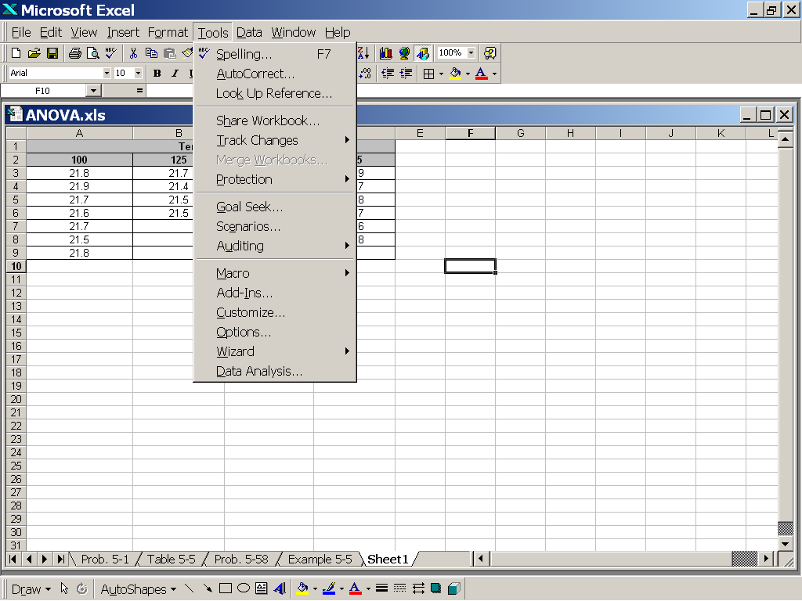
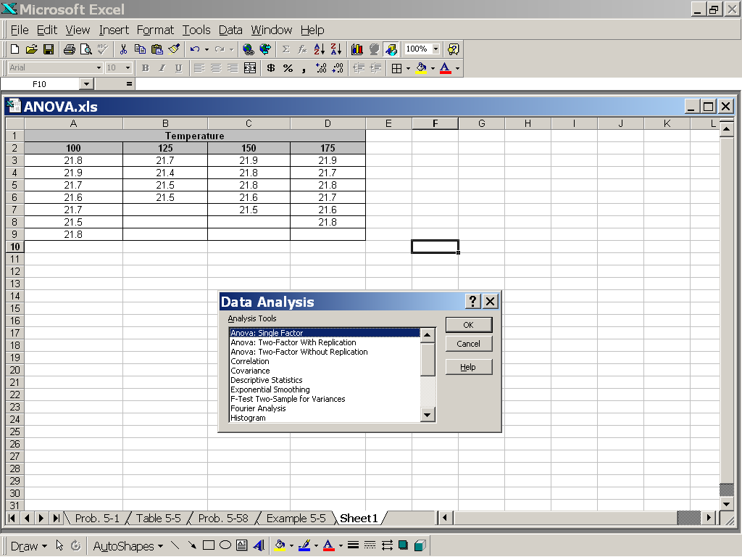
2. Go to Tools, then Data Analysis, then Anova: Single Factor

Slide 60
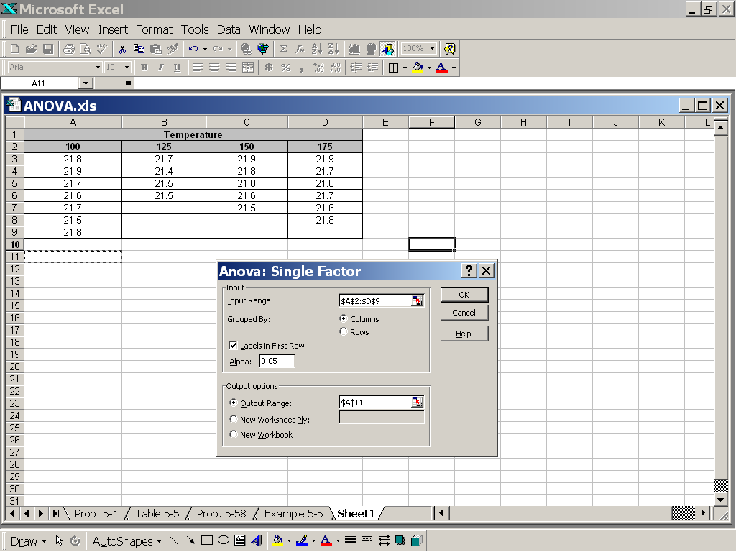
3. Click in the Input Range window
4. Highlight the treatment labels and all the data (in this case,
cell A2 through cell D9)
5. Select Grouped By
Columns
6. Select Labels as
First Row
7. Select the desired
Type I error level,
Alpha (α)
8. Click in the
Output Range
window and select any
cell in the sheet where
you want your results
to show (here cell A11)
9. Click Okay

Slide 61
What you should see
The p-value is .08 > .05, so we FAIL TO REJECT H₀
Excel will use the “average” n if there are not an equal number of observations
per treatment. In this case, n = (n₁₀₀ + n₁₂₅ + n₁₅₀ + n₁₇₅)/4 = (7 + 4 + 5 + 6)/4 = 22/4
Between Groups: Treatments
Within Groups: Observations

Slide 62
What you should conclude
Since p-value is > α, we fail to reject H₀ and conclude that temperature has no effect on brick density.. Same thing.

Slide 63
Randomized Complete Block Experiment
ANOVA

Slide 64
How is this application different from a completely randomized experiment (previous slides)?
If subjects that receive a particular treatment are the same, then we have a randomized block design
analogy is the paired t-test we did with the mazes
Block design removes differences among experimental subjects

Slide 65
Example of difference
Completely Randomized Experiment:
I have three arthritis medications. I want to know if there is a significant difference between them.
I enlist 12 people for my study and randomly assign them one of the three meds.
They report their pain indices (while on the medication) as scores between 0 (no pain) and 10 (most pain).
I will name these people Abe, Bob, Cal, Dave, Ed, Fred, Gary, Hal, Jon, Lee, Mike, Ned

Slide 66
Randomized Block Experiment:
Same study, but I want to eliminate the inherent differences between person 1, person 2, …, person 12.
For this study, I enlist four men: Rob, Sal, Ted and Vic
Each man gets to try each medication in sequence and reports his pain index from 0 (no pain) to 10 (high pain) while on each medication

Slide 67
Completely Randomized vs. Randomized Block
Completely Randomized
Randomized Block

Slide 68
ANOVA Notation: Randomized Block Experiment
Treatments: The aspects about which you are trying to determine a difference or not.
τ_{i} is the i^{th} treatment effect, typically measured as deviations from an overall process mean
n is the number of observations in a treatment.
When n is not the same for each treatment, we say the design is unbalanced.
a is the number of treatments
b is the number of blocks

Slide 69
The Hypothesis Test
H₀ in English….
There is no difference between the treatments with respect to measured observations
H₁ in English….
There is at least one treatment that is yield statistically different observations
Reject H₀ if p-value < α

Slide 70
We will use only Excel or
Minitab
to do this type of hypothesis test.

Slide 71
Example using Excel
1. Enter the data into an Excel sheet. Treatments need to be
in columns.
Note: No α is given, so I have chosen α = .05

Slide 72
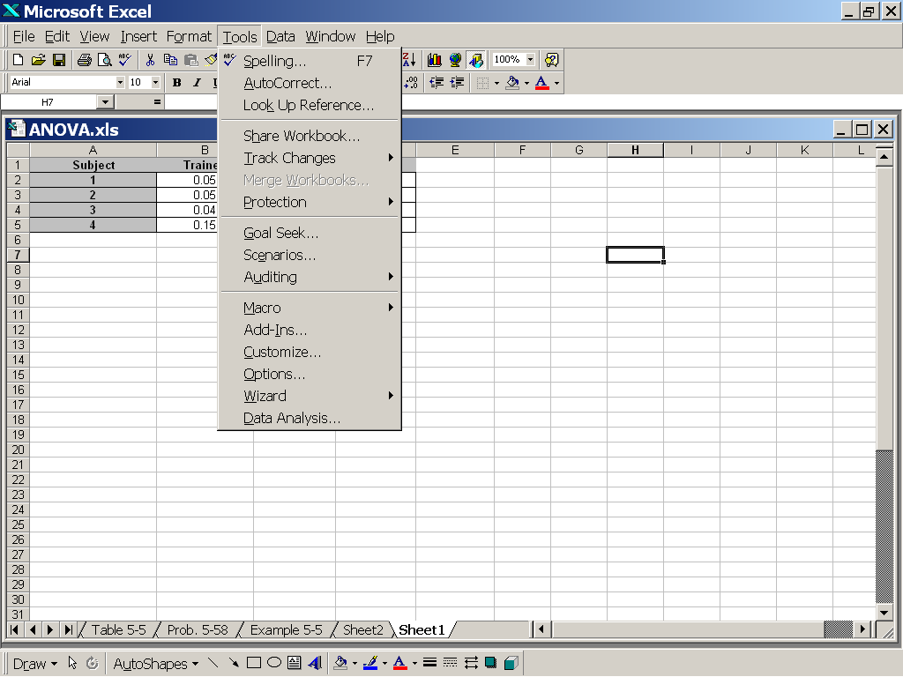
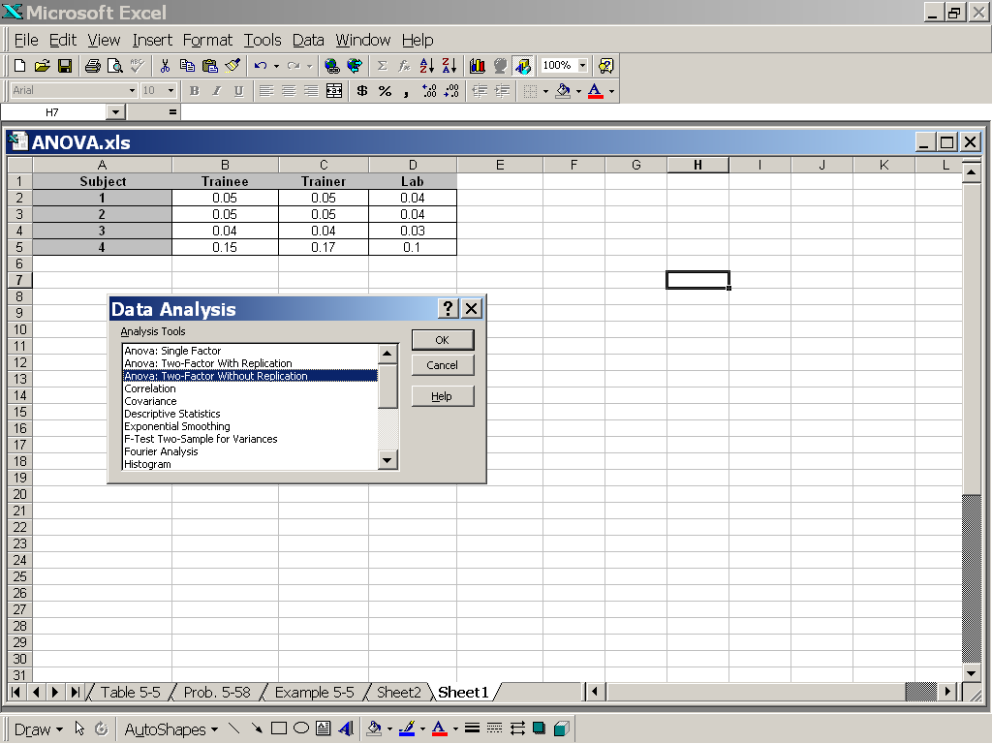
2. Go to Tools, then Data Analysis, then Anova: Two Factor
Without Replication

Slide 73
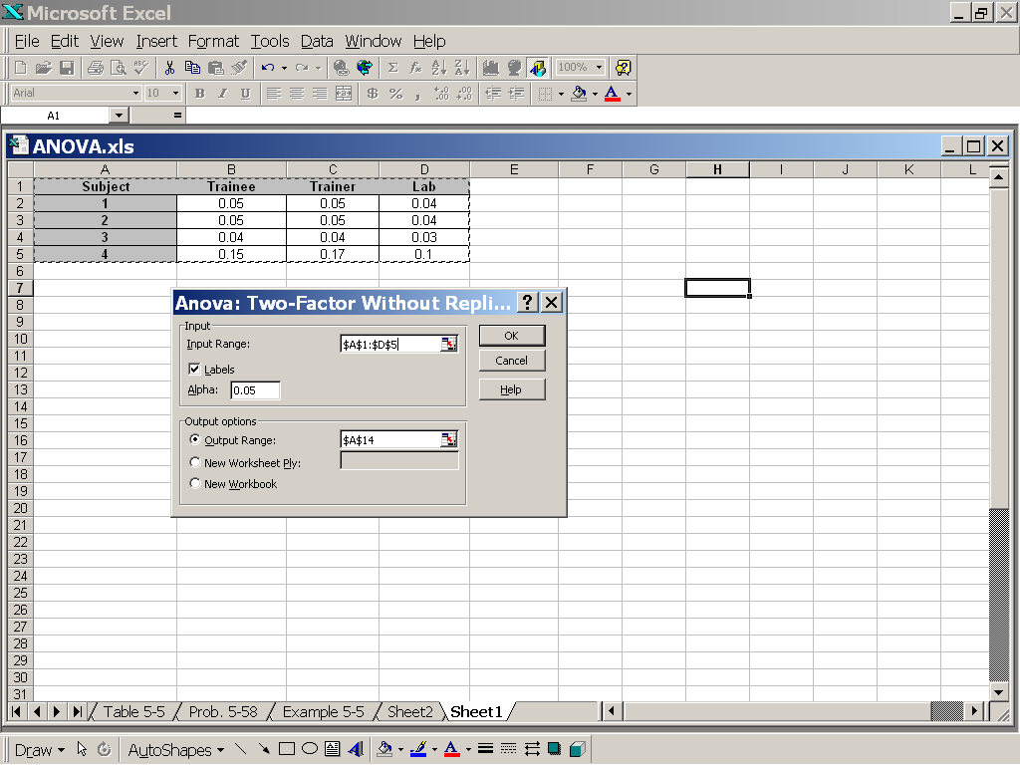
3. Click in the Input Range window
4. Highlight everything (in this case,
cell A1 through cell D5)!
5. Select Labels
6. Select the desired
Type I error level,
Alpha (α)
7. Click in the
Output Range
window and select any
cell in the sheet where
you want your results
to show (here cell A7)
8. Click Okay

Slide 74
What you should see
The p-value is .125 > .05, so we FAIL TO REJECT H₀

Slide 75
What you should conclude
Since p-value > α, we fail to reject H₀ and conclude that there is no difference in arsenic test procedure

Slide 76
Chapter 5 Summary
 | Case 1 | Case 5 | Case 2 | Case 3 | Case 4 | Case 6
Null Hypothesis | H₀ : μ₁ − μ₂ = Δ₀ |  | H₀ : μ₁ − μ₂ = Δ₀ | H₀ : μ₁ − μ₂ = Δ₀ | H₀ : μ _{d} = Δ₀ | H₀ : p₁ - p₂ = Δ₀
Test statistic
2-Sided Confidence Interval

